Slide 1
Day In the Life:
Planner

Slide 2
Agenda
This presentation is intended to introduce the daily duties and tasks of a Loudoun Water Planner.
The presentation is composed of the following modules:
Module 1: Managing Notifications
Module 2: Managing Work Orders
Module 3: Reporting
Notes:
SAP is software that integrates and streamlines business processes that span various applications and data sources. Using SAP, you can access and display the data and transactions you use to complete your tasks. This presentation discusses the approach and process for the Planner and how it is incorporated with SAP.

Slide 3
Summary
Summarized Topics
Planner creates/edits notifications
Planner creates work order based on notification
Even with automated work orders, Planner must review for accuracy and assign work order to the designated maintenance technician
Planner closes the work order in SAP once work is complete
Planner must generate Outstanding Notifications Report and open Outstanding Work Orders Report regularly to determine what notifications/work orders need to be addressed
Bulk of daily activities are devoted to analytics: Reviewing reports to ensure accuracy, manage duplicate requests, etc.

Slide 4
Overview Work Order Process Flow
Corrective Maintenance
Unplanned Corrective Maintenance
Emergency Maintenance
Preventative Maintenance (Automatic WO Creation)
Parts/ Supplies
Pre-Defined Work Steps
External Services
Create Work Order
Plan & Schedule Work Order
Execute Work Order
Settle and Close Work Order
Notifications
Labor
Preventive Maintenance Work Order
Material Requisitions
Reporting
Notes:
A Planner receives a notification (preventive, corrective, emergency, etc.) to create a work order. A planned work order includes pre-defined work steps, labor cost associated with the work, parts/supplies needed, and any external services that are needed as well. The work order is scheduled by the Planner, which assigns it to the employee tasked to complete the order. After the work is complete, and the employee has entered their time into ESS, a nightly batch settlement is generated to close the work order on the financials side. The Planner will then access the work order and mark it “technically complete”. Each month, the planner generates a report that shows work orders that have been technically complete, but not business closed . The Planner accesses the order again to complete the close of the work order. {Complete (Business)}

Slide 5





EAM - Notifications and Work Orders Process
Planner
Reviews outstanding Notifications; prioritizes and assigns work orders
Schedules Planned Maintenance and routine repairs/operations
Performs Analytics
Performs final sign-off on work orders
Maintenance Technician
Receives prioritized work orders via ECC paper printout
Obtains Necessary parts from Inventory or checks rolling inventory
Performs work, tracking actual parts used and time required
Closes work order using ECC with listing of components used and time taken; moves on to next work order and repeats process
End of day returns unused inventory to stock, if applicable.
Notes:
In light of a delayed mobile device deployment, for Go Live, Maintenance Technicians will use a combination of paper and SAP Desktop (ECC system) processes to manage work orders in the interim.

Slide 6
Module 1
Managing Notifications

Slide 7



Where Does a Notification Come From?
Create Work Order
Plan & Schedule Work Order
Execute Work Order
Settle and Close Work Order
Notifications
Notifications can be initiated a number of ways. It is the job of the planner to review all notifications to ensure they are valid and processed accordingly
Notifications can be automatically generated by SAP or created by the Planner themselves
Crew Chiefs, Maintenance Techs, etc. (anyone in LW), can initiate a notification
Customer Service receives a customer call and can initiate a notification or create a work order

Slide 8
Notification Actions
Create Work Order
Plan & Schedule Work Order
Execute Work Order
Settle and Close Work Order
Notifications
Specific actions a Planner must take when reviewing the notification include:
  Review notification for accuracy and classify according to priority
  Ensure it is not a duplicate notification prior to creating a work order
  Create the work order (work order can also be automatically generated by SAP)

Slide 9
Module 2
Managing Work Orders

Slide 10
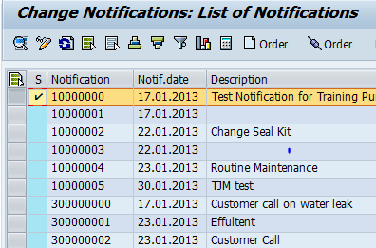
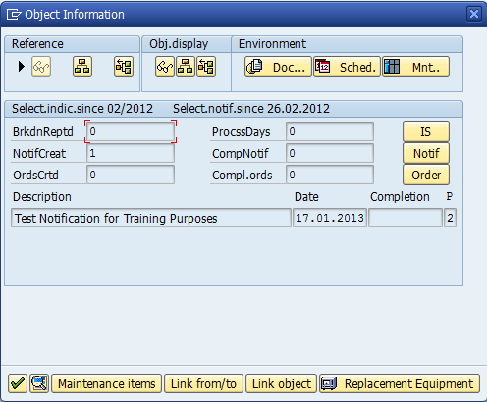
Create Work Order
Plan & Schedule Work Order
Settle and Close Work Order
Notifications
Creating a Work Order
Working from the notification, the Planner can begin to manually create the work order in ECC (SAP Back End system). If it’s automatically created (thru SAP or submitted by Customer Service), Planner must review WO for accuracy and assign to a maintenance tech.

Slide 11
Planning and Scheduling
Create Work Order
Plan & Schedule Work Order
Execute Work Order
Settle and Close Work Order
Notifications
When creating the work order, the Planner must perform the following activities:
  Determine skills needed to complete the work and coordinate the job schedule/priority with Supervisors
  Consult with Supervisors, Engineers, and Safety department to determine work conditions and special requirements that may have an impact on the job
  If needed, assign Bill of Materials and/or tasks lists to the work order
  Planner is responsible for assigning maintenance tech to all work orders created, with the exception of Field Service and Inspection work orders. Planner should still review for accuracy

Slide 12

Release a Work Order
Create Work Order
Plan & Schedule Work Order
Execute Work Order
Settle and Close Work Order
Notifications
Planner
Maintenance Technician
Planner must release and print work order for Maintenance Tech to receive and process. The work order is released by clicking the Release icon
Until mobility is available, maintenance tech receives work order via paper printout from ECC system
Notes:
In light of a delayed mobile device deployment, for Go Live, Maintenance Technicians will use a combination of paper and SAP Desktop (ECC system) processes to manage work orders in the interim.

Slide 13

Close a Work Order
Create Work Order
Plan & Schedule Work Order
Execute Work Order
Settle and Close Work Order
Notifications
Once the work is complete and the employee has entered their time into ESS, the Planner must close the work order:
  A behind the scenes batch settlement is automatically generated nightly to close the financials of the work order
  Planner accesses the work order and clicks the Complete (Technically) icon
  Once a month, planner generates report that shows work orders that have been technically complete, but not business closed . The Planner accesses the order again to complete the close of the work order. {Complete (Business)}
*** Running settlement close and completing the business close of a work order is done monthly. Marking an order technically complete should be done immediately once work is complete and time is entered into ESS!***
Notes:
Month end reports generated are standard list edit reports. Transaction codes IW32 or IW72

Slide 14
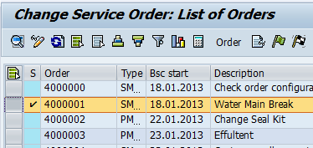
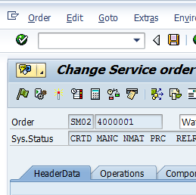
Create Work Order
Plan & Schedule Work Order
Execute Work Order
Settle and Close Work Order
Notifications
Close a Work Order (ECC)
Before closing a work order, after batch settlement runs, the Planner must can mark the order as technically complete. At month end, it can then be marked as business complete.
After batch settlement has been generated, click the Complete (Technically) icon to technically close the work order.
At month end, follow the menu path Order – Functions – Complete – Complete (business) to officially close the order.
1
1
2
2

Slide 15
Module 3
Reporting

Slide 16
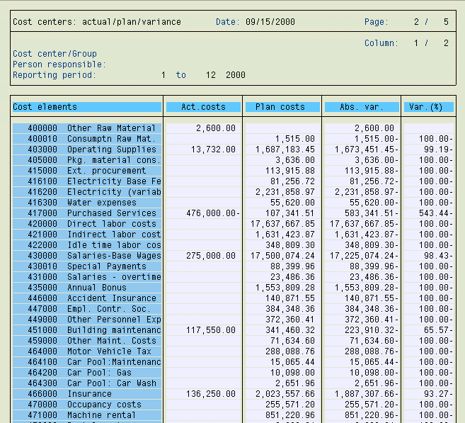
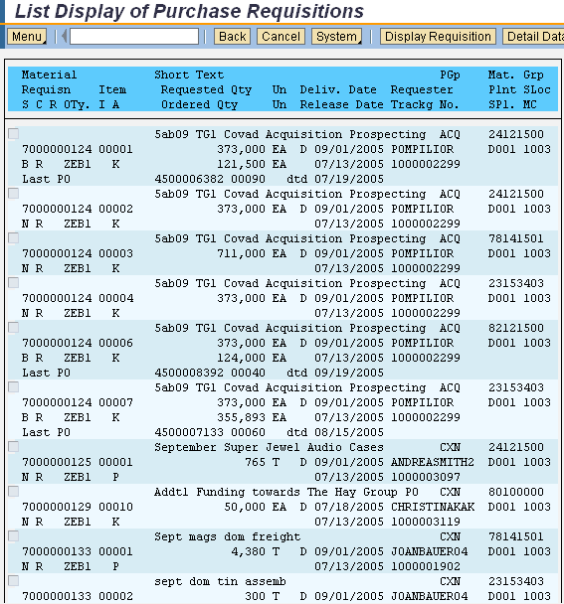


Generating Reports - Analytics
Planners typically dedicate daily time to analyzing various reports. Planners must generate:
  Outstanding notifications report hourly
  Outstanding work orders report hourly
  Closed notifications and work order reports regularly for reconciliation purposes
  “In Process” reports for review to ensure all required resources are available and work is progressing
Open Work Order Report
Open Notifications Report
Planner Reporting
Planner
Reporting
Notes:
You can add reports you use most often to your Favorites folder.
Access to reports is restricted by the role(s) assigned to the user – for example, not everyone has the ability to generate capital project reports. And for those that are able to generate budget reports, your access is limited to just your department. You are not be able to see another department’s budget.

Slide 17
Sample of Reports Generated by the Planner
Report | Purpose
IW28 – Change Notifications: Selection of Notifications | Displays a list of open or in process notifications
IW38 – Change PM orders: Selection of Orders | Displays a list of open or in process Plant Maintenance orders
IW72 – Change Service Order: Selection of Orders | Displays a list of open or in process service orders
IW37N – Change Orders and Operations: Selection of Orders and Operations | Display a list of open or in process orders and operations

Slide 18
Summary

Slide 19
Miscellaneous Duties
Outside of managing notifications and work orders, a Planner can also participate in the following tasks:
  Working with the Master Data Tech to create and review bills of materials, tasks lists, and maintenance plans (outside of SAP. Master Data Tech will enter/maintain in SAP)
  Request and obtain proposals and quotes from vendors (Shared duties between Procurement/Inventory/Planner)
  Create and submit purchase requisitions (Shared duties between Procurement/Inventory/Planner)
  Return unused materials to stock (Shared duties between Procurement/Inventory/Planner)

Slide 20
Miscellaneous Duties (Cont.)
  Prepare project schedules and conduct plant staff meetings
  Monitor work backlogs and schedule compliance, and review with plant Supervisors
  Create standard operating procedures for various preventative and corrective maintenance tasks
  Monitor and analyze PM tasks and maintenance plans for effectiveness and modify frequency of PMs as necessary
  Review planned vs. Actual work and modify if needed to optimize capacity planning

Slide 21
Summary
Summarized Topics
Planner creates/edits notifications
Planner creates work order based on notification
Even with automated work orders, Planner must review for accuracy and assign work order to the designated maintenance technician
Planner closes the work order in SAP once work is complete
Planner must generate Outstanding Notifications Report and open Outstanding Work Orders Report regularly to determine what notifications/work orders need to be addressed
Bulk of daily activities are devoted to analytics: Reviewing reports to ensure accuracy, manage duplicate requests, etc.

Slide 22

Questions

